Slide 1
SOCS3 expression in
3 different types of LCL
Yongjia Feng
6/21/2025

Slide 2
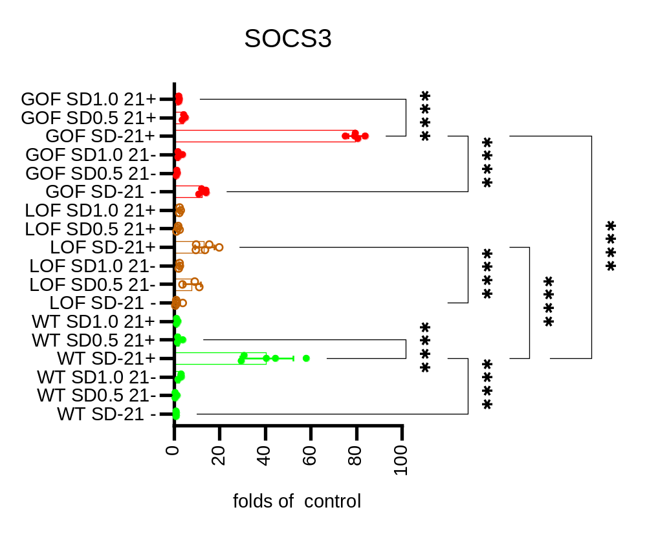
SD = stat3 degrader
21+ = IL21 stimulus (vs 21-)
SOCS3 detected by rtPCR
Gain of function
Low STAT3 function
Wildtype
Wildtype without SD2301 & IL21 as control in bottom lane

